Slide 1
Intelligent Forecasting On Covid-19
May 27 2020

Slide 2
summary
KPMG lighthouse intelligent forecasting on Covid-19
Business Challenge
Since the COVID-19 outbreak was first diagnosed, it has spread to over 190 countries and all U.S. states. The pandemic is having a noticeable impact on global economic growth. Business owners need to understand how to adjust their financial budget based COVID-19.
Approach & Solution
Using predictive data analytics, KPMG’s Lighthouse has developed serval methodologies to identify the economic impact of COVID-19.
Leveraging mobility data and COVID-19 data to spot patterns and perform sensitivity analysis enable us to predict what will happen in the following fall and winter.

Slide 3
Model Structure
KPMG lighthouse intelligent forecasting on Covid-19
Data Sourcing
KPMG Lighthouse generates both short-term accurate COVID-19 new cases forecast and long-term COVID transmission trend forecast and Economic impact.
The short-term model is a signal-based time series model to generate one or two months COVID-19 new cases forecast
The long-term models are assumption based compartmental model and regression model, it uses different scenario assumption to create a long-term trend estimate of COVID-19 cases and mobility index
Finally, Lighthouse ensembles all prediction results together to estimate the economic impact of COVID-19
Short-Term COVID Case Forecast
Long-term Transmission Trend Forecast
Mobility Index Prediction
Covid-19 Economic Impact

Slide 4
Short-term Modeling approaches
KPMG lighthouse intelligent forecasting on Covid-19
Selected Model Type
Time Series
models
KPMG incorporates ensemble modeling along with time series analysis (Bayesian structural Time Series and Facebook Prophet Time Series models) and different feature weighting methods to provide a more robust short-term and long-term prediction, including COVID-19 transmission trends and epidemiological seasonality.
Candidate Model Type
Traditional statistical analysis
KPMG’s advanced analytics can identify which signals are the most correlated to the target variable through rigorous statistical testing. The methodology relies on established statistical approaches, such as Elastic Net Regression and Piecewise regression. This approach cannot capture seasonality well, the performance is worse than the time series model.
Compartmental models
KPMG leverages this approach to simulate the COVID-19 trend in the following fall and winter. In this model approach, the population is assigned to compartments with labels - for example, Susceptible, Infectious, or Recovered (SIR). However, due to the difficulty of setting the correct assumption, we did not include this model in the final pipeline.

Slide 5
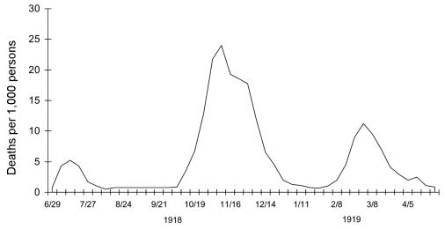
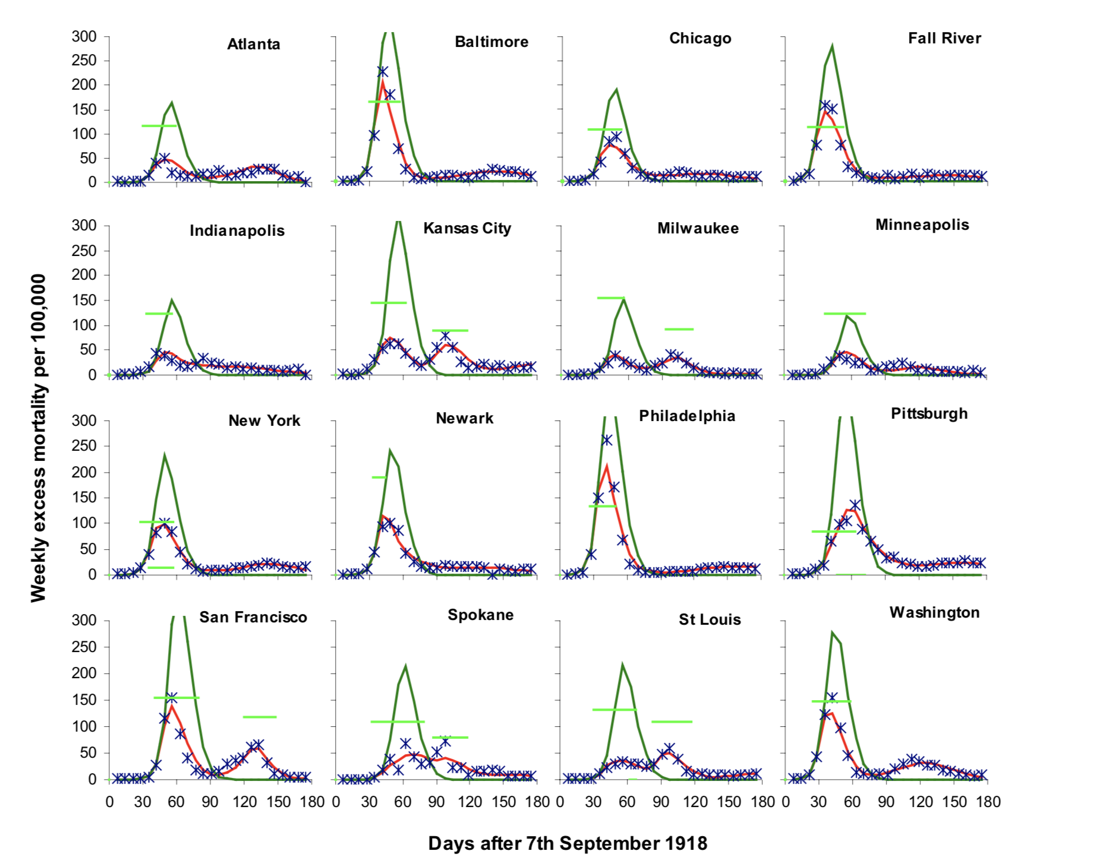
Long-term Modeling approaches
KPMG lighthouse intelligent forecasting on Covid-19
1918 Spanish Flu Pandemic Waves
The long-term models are assumption based time series models and regression models, it uses different scenario assumptions (based on 1918 Spanish Flu waves, and other scenario estimations) to create a long-term trend estimate of COVID-19 cases and mobility index
Based on the different trends in different cities, we created different scenarios for the second wave of COVID-19. This assumption based approach can help us predict what will COVID-19 transmission trend look like in the following fall and winter.

Slide 6
Modeling Comparison
KPMG lighthouse intelligent forecasting on Covid-19
Advantages
Disadvantages
Time Series
models
Time Series models can capture the different COVID-19 transmission weekly and monthly seasonality to make long-term forecasts.
It relies on historical data trends and patterns. It might be hard to time series models to predict accurately if there is a structural change in the target variable.
Traditional statistical analysis
Easily identify a similar COVID-19 transmission trend between different countries and states, and using the lagging variable to make accurate predictions
Due to the lack of available COVID-19 data, this model type can only be used in the short-term forecast
Compartmental models
It is an assumption based mathematical simulation model. It can allow users to set different reproduction number (R0) for different target
The actual R0 value is hard to find and predict, and a number of factors including temperature, cultural habits can change it.

Slide 7










Selecting the right signals
KPMG lighthouse intelligent forecasting on Covid-19
Powerful pandemic forecasts start by selecting the right signals.
KPMG has identified broad range of signals. The external predictors track not only COVID-19 data but also industry specific economic index, like lockdown index and states by states mobility data.
When building an Advanced Forecasting Engine, KPMG will utilize internal forecast enablers to help us to select the right signal and improve the forecast accuracy.
Data Sources

Slide 8
Model Pipeline – High Level
KPMG lighthouse intelligent forecasting on Covid-19
The high-level model pipeline including, data cleaning, signal selection, model selection, and model prediction. We not only forecast the COVID-19 daily new reported cases, but also predict the mobility data, and use mobility data as an indicator for the economic activity.
Data Input
Signal Selection
Model Selection & Prediction
Model Output
COVID-19 New Cases By Country & By State
KPMG Forecast Enablers
AI-based modeling suite and execution engine
Correlation Analysis
Covid-19 New Cases
COVID-19 Death Data
Geographic Location
Model-Based Signal Selection
Lockdown Index
Mobility Prediction
Population
Forward & Backward Signal Selection
Mobility Data
Learning loop

Slide 9
Appendix: Model Fitting Algorithms
Analytics background info

Slide 10
Time Series Model Fitting Algorithms
KPMG lighthouse intelligent forecasting on Covid-19
Candidate Models | Description | Note
ARIMA | AutoRegressive Integrated Moving Average Model. It is a class of model that captures a suite of different standard temporal structures in time series data. | Fast, old-school classy model, usually present us with a very good starting points for benchmarking
(BSTS) Bayesian Structural Time Series | Consists of Kalman filter for time series decomposition, Spike-and-slab for feature selection and Bayesian model averaging for prediction. | Performance is good when data size is adequate
(VAR) Vector Autoregression | A generalization of the univariate AutoRegressive model. It is used to capture the linear interdependencies among multiple time series. | Multi-variate TS Model, good when need to capture inter-variable relationships
FB Prophet | A procedure for forecasting time series data based on an additive model where non-linear trends are fit with yearly, weekly, and daily seasonality, plus holiday effects. | Good performance, great at capturing seasonality effects
TBATS | Modeling framework for forecasting complex seasonal time series such as those with multiple seasonal periods, high frequency seasonality, non-integer seasonality and dual-calendar effects. This framework incorporates BoxCox transformations, Fourier representations with time varying coefficients, and ARMA error correction. | Seasonality is allowed to change slowly over time
SNAIVE | The seasonal naïve method accounts for seasonality by setting each prediction to be equal to the last observed value of the same season. | Simple and easy to interpret
Monthly Score

Slide 11
Traditional statistical & Compartmental Model
KPMG lighthouse intelligent forecasting on Covid-19
Candidate Models | Description | Note
Elastic Net Regression | The elastic net is a regularized regression method that linearly combines the L1 and L2 penalties of the lasso and ridge methods. | It can be used in signal selection and the long-term trend estimate
Piecewise regression | It is a method in regression analysis in which the independent variable is partitioned into intervals and a separate line segment is fit to each interval. Segmented regression analysis can also be performed on multivariate data by partitioning the various independent variables. | Hard to predict the COVID-19 pandemic change points and might overfit the history
SIR | An SIR model is an epidemiological model that computes the theoretical number of people infected with a contagious illness in a closed population over time. The name of this class of models derives from the fact that they involve coupled equations relating the number of susceptible people S(t), number of people infected I(t), and number of people who have recovered R(t). | Highly sensitive to the model assumption
SEIR | The SEIR models the flows of people between four states: susceptible (S), exposed (E), infected (I), and resistant (R). Each of those variables represents the number of people in those groups.
Monthly Score

Slide 12
Appendix: Model Result Samples
Analytics background info

Slide 13
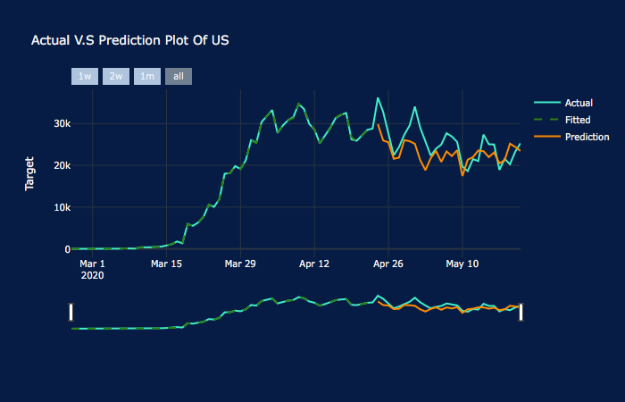
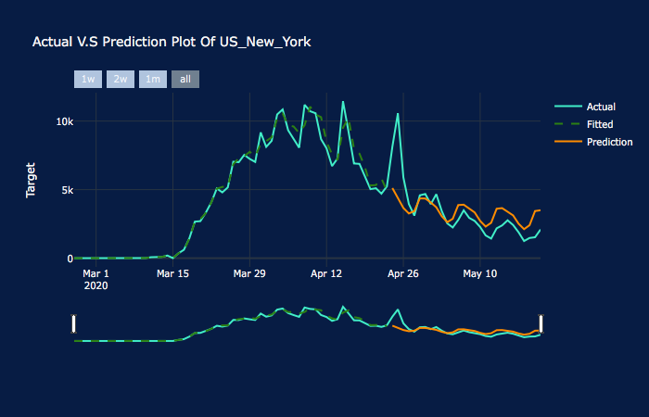
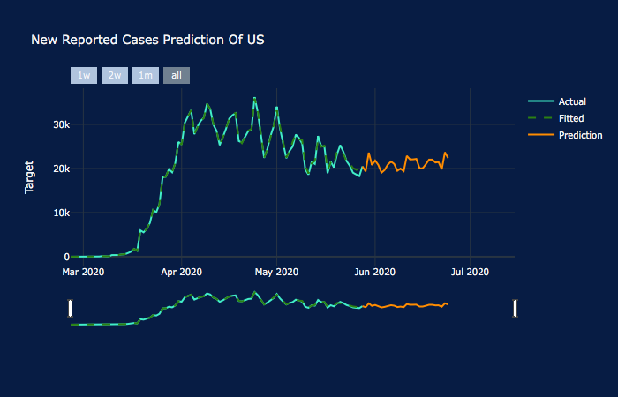
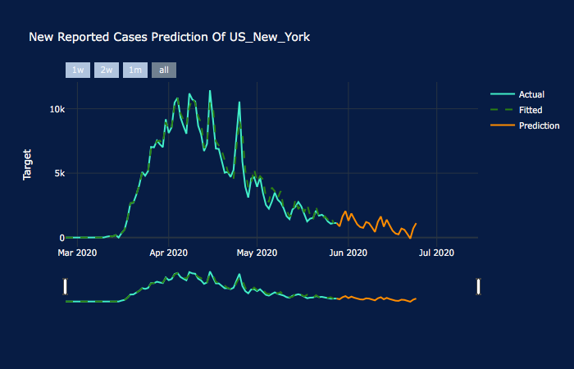
Model Validation & Prediction Results
KPMG lighthouse intelligent forecasting on Covid-19
Monthly Score

Slide 14
Some or all of the services described herein may not be permissible for KPMG audit clients and their affiliates.
kpmg.com/socialmedia
The information contained herein is of a general nature and is not intended to address the circumstances of any particular individual or entity. Although we endeavor to provide accurate and timely information, there can be no guarantee that such information is accurate as of the date it is received or that it will continue to be accurate in the future. No one should act on such information without appropriate professional advice after a thorough examination of the particular situation.
© 2017 KPMG LLP, a Delaware limited liability partnership and the U.S. member firm of the KPMG network of independent member firms affiliated with KPMG International Cooperative (“KPMG International”), a Swiss entity. All rights reserved. NDPPS 726210
The KPMG name and logo are registered trademarks or trademarks of KPMG International.

